Slide 1
Rigor & Reproducibility Discussions
April 1: p-hacking, HARKing and Publication Bias
April 15: Randomization, Blinding, Sample Size
April 29: Data Management Plans
May 13: Tidy Data
May 27: Pre-Registration

Slide 2



Questionable Research Practices and Publication Bias
April 1, 2025
Carol Wilusz, Professor, Colorado State University
Fulbright Scholar to the Czech Republic 2025

Slide 3
Objectives
Discuss why p-hacking and HARKing lead to experiments that can’t be reproduced
01
Understand how the current publishing culture encourages these practices
02
Explore ways to ensure you are not part of the problem
03

Slide 4

Did anything in the material provided surprise or concern you?

Slide 5

Might you be guilty of any of these questionable practices?

Slide 6
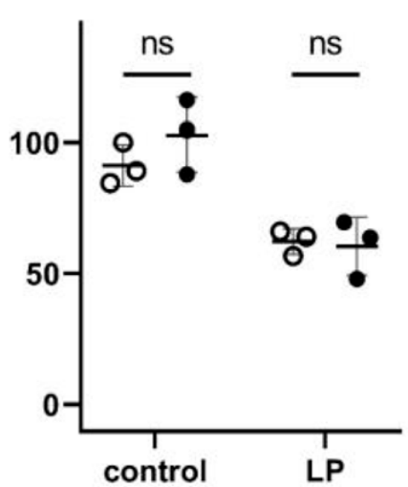
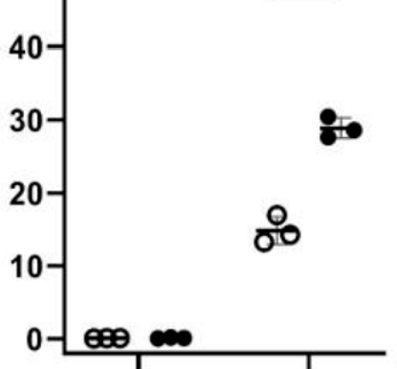
Why do we use the p-value?
p-hacking…..

Slide 7
Why do we use the p-value?
Help make decisions and interpret results
Easy to calculate
Historically accepted and widely used
Broadly applicable across different tests

Slide 8
What are some problems with p-values?

Slide 9
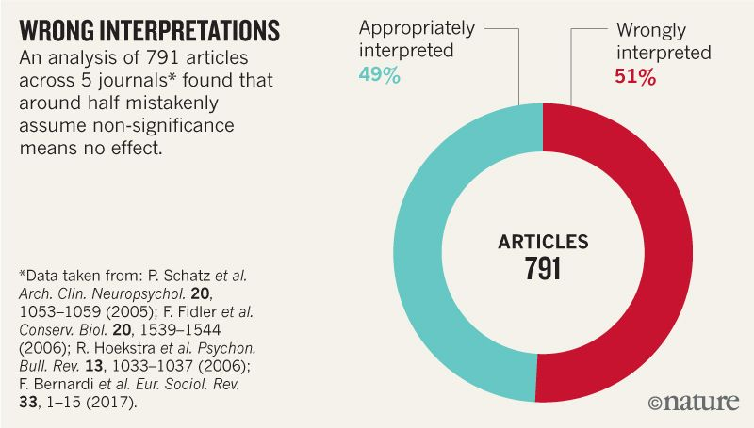
What are some problems with p-values?
Frequently misinterpreted or misused
Leading to Type I (false positive) and Type II (false negative) Errors
Dependent on sample size and effect size
Fisher (1973) intended the P-value to be combined with other sources of information from within and outside the study, often based on background knowledge. Thus, the researcher is not to place sole reliance on the P-value as a means of reaching a conclusion. [https://www.sjsu.edu/faculty/gerstman/EpiInfo/pvalue.htm]

Slide 10
What does the p-value tell you?
The probability that there is a difference in the results between the conditions being tested
The probability of obtaining results as extreme as, or more extreme than, the observed results, even if there is no actual effect.
The size or importance of the observed effect
The probability that the data were produced by random chance alone
p=0.05
Intelligence
C/C APR1
A/A APR1

Slide 11
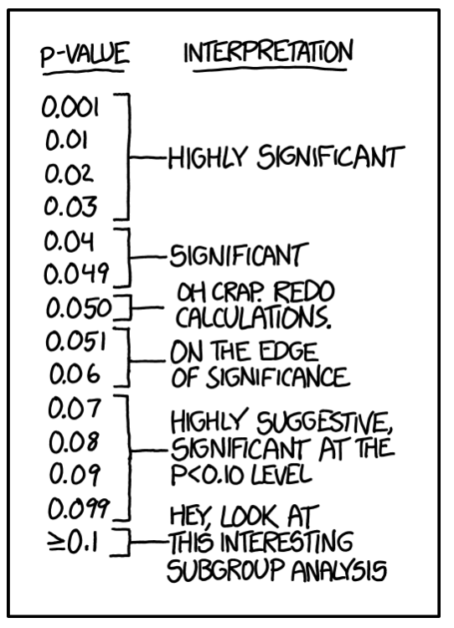
Why is p=0.05 “magic”? Is there a better way?

Slide 12
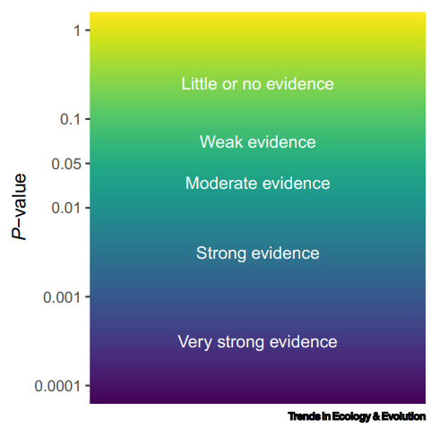
Alternative language and interpretation
https://doi.org/10.1016/j.tree.2021.10.009 Muff et al Trends in Ecology & Evolution

Slide 13
Are you aware of any alternatives or complementary approaches to the p-value?

Slide 14
So what can you do when your data looks like this??
p=0.055
Ctrl
Expt

Slide 15
So what can you do when your data looks like this??
Look at other measurements to provide more context
p=0.055
Confidence Interval
False discovery rates
Effect size *
Statistical power of the study to detect the effect (post-hoc)
Report the p-value as “weak evidence”
Repeat the experiment to see if the results are reproducible
Effect size
Ctrl
Expt
* 10% increase can be very significant (e.g. pay rise) or irrelevant (e.g. 10 vs 11 min to wait for a bus)

Slide 16

Why is p-hacking still happening?

Slide 17
Why is p-hacking still happening?
Publication bias [p<0.05 required]
Pressure to publish
Ignorance of best practices
Desire for positive results and/or new information encourages exploration
Limitations of time and $ on replication and design of experiments
Poor planning at experimental design stage allows too much freedom in analysis

Slide 18
Whenever a researcher chooses what to present based on statistical results, valid interpretation of those results is severely compromised if the reader is not informed of the choice and its basis.
Wasserstein, R. L., & Lazar, N. A. (2016). The ASA Statement on p-Values: Context, Process, and Purpose.
The American Statistician, 70(2), 129–133. https://doi.org/10.1080/00031305.2016.1154108

Slide 19
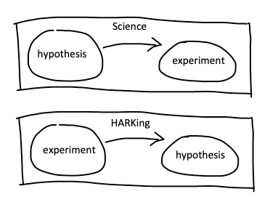
HARKing Is it always a bad thing?

Slide 20
HARKing Is it always a bad thing?
Confirmatory/Hypothesis Driven Research
Exploratory Research

Slide 21
What are some differences between confirmatory and exploratory research?

Slide 22

Confirmatory versus Exploratory Research
Confirmatory
Exploratory
Tests a hypothesis, usually generated based on prior knowledge of the problem
Methods and analyses can (and should!) be defined at the outset
Results provide evidence to confirm or refute the hypothesis
E.g. Does knockout of the APR1 gene increase foolishness in C. elegans?
Generates new hypotheses based on the data collected
Methods, especially for analysis, may be flexible
Results identify patterns and trends for further investigation
E.g. What happens to C. elegans when we knockdown APR1?

Slide 23
Confirmatory versus Exploratory Research
Confirmatory
Exploratory
Tests a hypothesis, usually generated based on prior knowledge of the problem
Methods and analyses can (and should!) be defined at the outset
Results confirm or refute the hypothesis
E.g. Based on its expression in brain, does knockdown of the APR1 gene increase foolishness in C. elegans?
Generates new hypotheses based on the data collected
Methods, especially for analysis, may be flexible
Results identify patterns and trends for further investigation
E.g. What happens to C. elegans when we knockdown APR1?
-> Evaluate multiple measures of C. elegans health (may include foolishness)
-> Evaluate foolishness

Slide 24
What % of C. elegans genes show no overt phenotype when knocked down?
10%
35 %
50%
85%
100%
Ramani et al (2012) doi: 10.1016/j.cell.2012.01.019 The majority of animal genes are required for wild-type fitness

Slide 25
So ANY experiment looking for a worm knockdown to have ANY phenotype is already quite likely to be unsuccessful!
85% of genes have no phenotype
Of the remaining 15% - some genes are essential (phenotype is death!), and the remainder are divided among multiple phenotypes that require different assays to detect them!

Slide 26

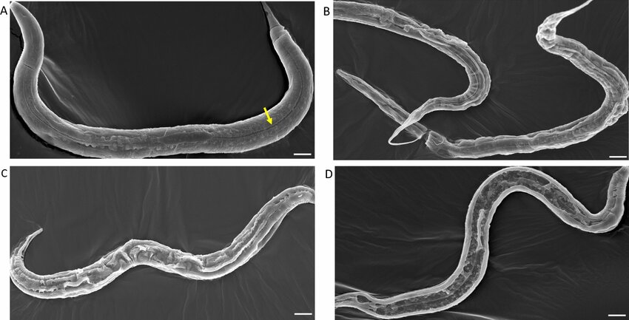

Prior knowledge guides you where to look (and vastly improves your chances of success)!
APR1 expressed in brain
Maybe APR1 is required for worms to make smart decisions?
Evaluate decision-making

Slide 27

Both exploratory and confirmatory research can get to the right answer (with the right experiment)
Confirmatory
So does it matter how you report it?
Exploratory
movement
movement
gut development
gut development
foolishness
foolishness
length
lifespan
length
lifespan
# of offspring
# of offspring
response to alcohol
response to alcohol
fertility
fertility
Simple t-test may be sufficient
Statistical analysis must adjust for multiple tests!!

Slide 28

Knocking down APR1 does not make worms more foolish, but it does clearly make them longer
Confirmatory
Exploratory
movement
movement
gut development
gut development
foolishness
foolishness
lifespan
length
lifespan
length
# of offspring
# of offspring
response to alcohol
response to alcohol
fertility
fertility

Slide 29
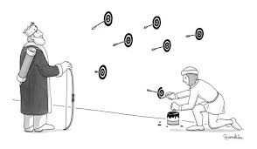


What is the problem with changing the hypothesis to “APR1 affects length”?
This Photo by Unknown Author is licensed under CC BY-NC

Slide 30
What is the problem with changing the hypothesis to “APR1 affects worm length”?
It is not based on established knowledge
Without further investigation it’s unclear whether the observation is reproducible or even connected to the gene of interest (could be a random mutation)
The experiment can never result in the null hypothesis being rejected because the alternative hypothesis was generated to fit the results
The statistical analysis will be questionable (not corrected for multiple tests)
Others may waste time testing the foolishness hypothesis (which was based on prior knowledge) again
Future studies will be based on a weak premise (your chance observation which could be a false positive)
Reviewers cannot correctly evaluate your analysis because you haven’t been transparent about how you got the results

Slide 31
But the observation is still there – what can you do??
Confirmatory
Exploratory
movement
movement
gut development
gut development
foolishness
foolishness
lifespan
length
lifespan
length
# of offspring
# of offspring
response to alcohol
response to alcohol
fertility
fertility

Slide 32
Some options
Write the paper describing your hypothesis and your original experiment TRANSPARENTLY.
Knockdown of APR1 in worms does not affect foolishness
Write the paper describing your hypothesis and your original experiment TRANSPARENTLY and include the observation that length increases - suggest an explanation in the discussion
Knockdown of APR1 does not affect foolishness but may result in longer worms
Design an experiment to reproduce the observation that the length increases with a different batch of worms. Write the paper TRANSPARENTLY describing your original hypothesis and the negative results, include the preliminary observation and hypothesis that arose from it along with the confirmatory data.
Knockdown of APR1 results in longer worms but does not affect foolishness
Notes:
Will it get published?
Are you confident it can be reproduced?

Slide 33


Pre-registration
Pre-register with a journal, with your PI, or with yourself!
Hypothesis and predicted outcome
Experiment design
Blinding
Randomization
Sample Collection Protocols
Existing Data (can help you estimate effect size, power)
Data collection
Inclusion/Exclusion criteria
Stopping rules
Variables
Manipulated variables
Measured variables
Statistical Analysis Plan

Slide 34
Why is p-hacking still happening?
Publication bias [p<0.05 required]
Pressure to publish
Ignorance of best practices
Desire for positive results and/or new information encourages exploration
Limitations of time and $ on replication and design of experiments
Poor planning at experimental design stage allows too much freedom in analysis

Slide 35
What is Publication Bias?
“the publication or non-publication of research findings based on the nature and/or direction of their results”

Slide 36
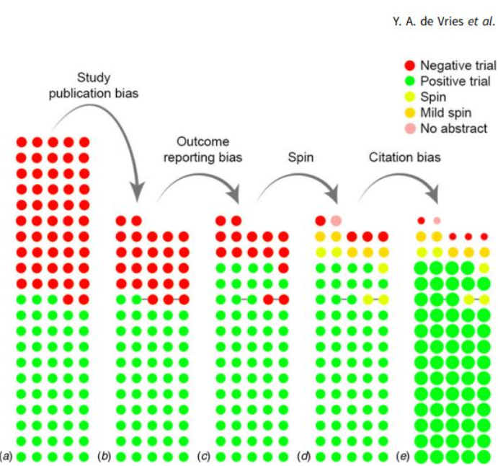
Publication Bias Inflates Perceived Efficacy of Depression Treatments
Total # trials
Total # published
~50% negative
~33% negative
~15% negative
~8% negative
https://www.madinamerica.com/2018/08/publishing-bias-inflates-perceived-efficacy-depression-treatment-study-finds/

Slide 37
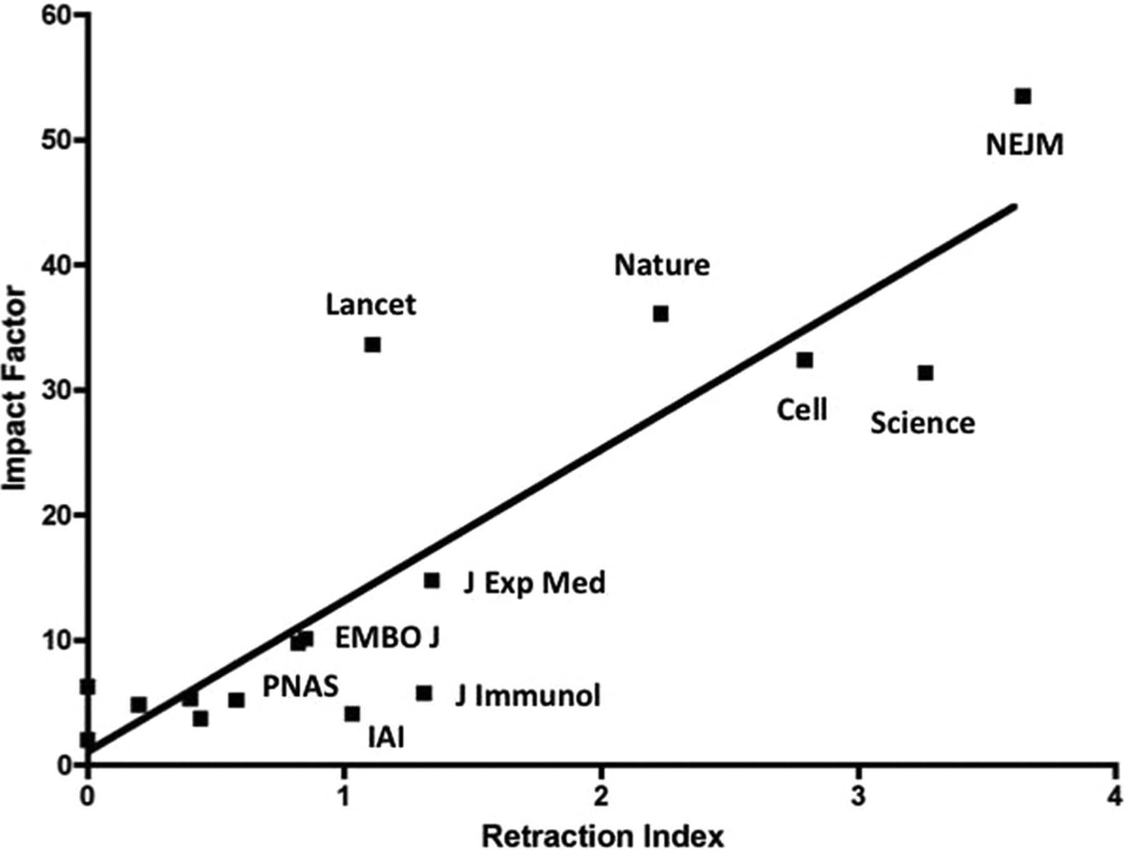
How do you explain this?
Fang FC, Casadevall A, 2011. Retracted Science and the Retraction Index. Infect Immun 79:.https://doi.org/10.1128/iai.05661-11

Slide 38
How do you explain this?
higher readership -> more scrutiny
extremely novel findings that contradict current thinking are more likely to be false positives
i.e. top journals are biased towards publishing novel discoveries, and take more risks
Fang FC, Casadevall A, 2011. Retracted Science and the Retraction Index. Infect Immun 79:.https://doi.org/10.1128/iai.05661-11

Slide 39
What do we mean by “negative results”?

Slide 40
What do we mean by “negative results”?
Results that favor the null hypothesis?
Results that fail to confirm other studies?
Results that are poor quality?
Are negative results less likely to be valid?
Are they less important / informative?
What makes them difficult to publish?
What are the pros and cons to publishing negative results?

Slide 41
What are some consequences of Publication Bias?
AI models are trained on the literature – if the literature lacks negative data then the models don’t work
Researchers build only on positive (and sometimes flawed) results
Time and money wasted repeating experiments that will never give positive results

Slide 42

Take home messages
Always be transparent about what you did and why
Plan your statistical analyses before you start (and stick to the plan)
Know your limitations - ask an expert or get training
Include your “negative” results
Put less weight on p<0.05 – use other observations to support your interpretations and decisions
Pre-register your plans (even if it’s just with yourself!)
Allow sufficient time and money to do the experiment rigorously
Be more positive about negative data, and replication studies
FDR
CI
Effect size
p =0.xx
p<0.05

Slide 43

Next time (April 15)
This Photo by Unknown Author is licensed under CC BY-SA-NC
Randomization, Blinding and Sample Size

